Slide 1
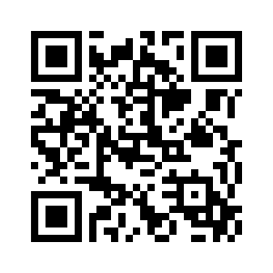
Ensemble Programming
/ Mob
Participate Live!
https://app.sli.do/event/me4gojm4wtbikS3y6wz5wZ
Notes:
Mobbed this presentation

Slide 2
Learning is not just a normal work activity.
Learning is the work.
Notes:
Ensemble programming is the embodiment of this quote. It does not even pretend to care about efficiency in the form of “fingers on keyboard equals more code written”. Baked into its topology is the understanding that maintainable, clean code, is the only way forward. That individuals and interactions are valued higher than processes or tools for sharing knowledge.
That “writing code” is only one small part of software development, when we all work together working software is delivered through the entire system faster so that we can receive feedback quicker. Ultimately, that we must “slow down” in order to go faster.
This heuristic strongly applies for software development & engineers but also agile organizations as a whole. “We are uncovering better ways of developing software by doing it and helping others do it.”.

Slide 3
What Is A Team?
1

Slide 4
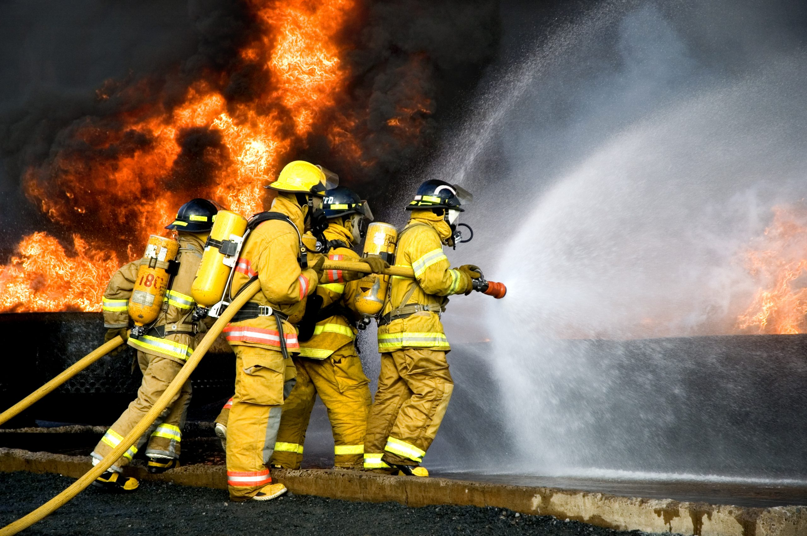

Slide 5
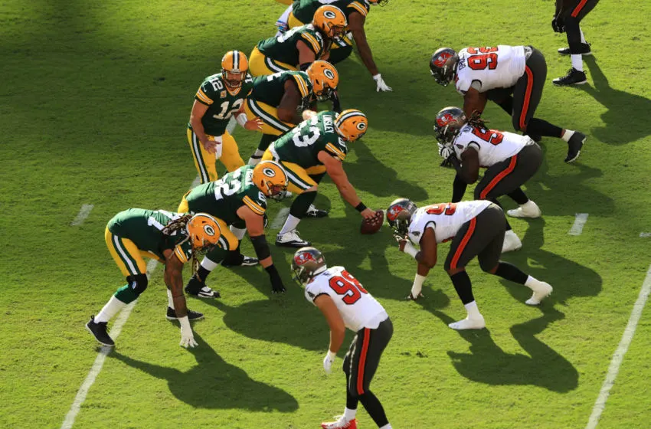

Slide 6
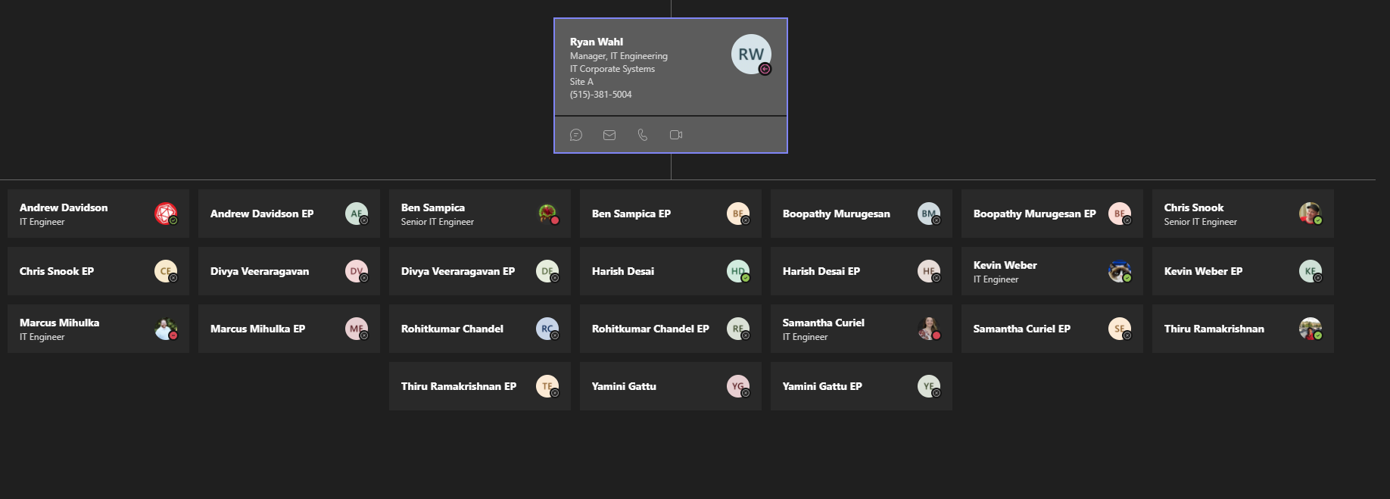

Slide 7


Slide 8
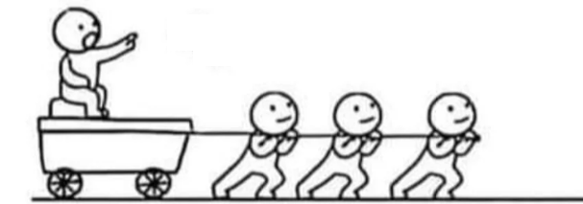

Slide 9
Does your team work like this?

Slide 10
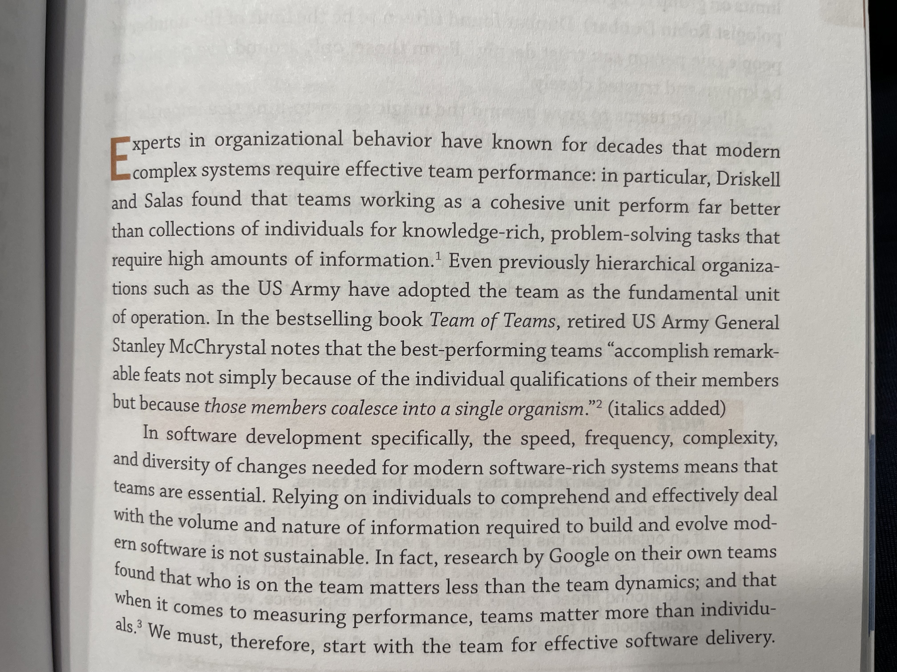
Team Topologies

Slide 11
Understanding Systems Thinking
2

Slide 12
Road to Valuable Software
Someone asks for something Maybe through a proxy (PO) or directly to a SE
Release (production is best)
Write the thing
1
3
5
2
4
6
Prioritized against the current thing team is doing
Yes / No
Gather feedback from what you wrote from devs
Gather feedback from what you released from
stakeholders

Slide 13
Negotiation of the ask
Analyzing architecture for current problem
Proving the production code you wrote works
Analyzing overarching architecture
Monitoring
Gathering feedback
Working around existing code concerns
Working around legacy code concerns
Valuable Software
May Require…
Dev review
Writing the production code
Figuring out how much access they need
QA review
Figuring out who needs access
Designing UI
Researching potential new ways of solving the problem
Designing new architecture
Proving the production code you wrote didn’t break everything
Performance Testing
Refactoring
Releasing

Slide 14
Developer Feedback
I have had concerns over the contents of a pull request but I felt it was too late to do anything about it?

Slide 15
Software development is inherently a social activity. Software is built for people by people. The developers need to talk to people to understand what to build. They need to get input on what they are doing from their team before, during, and after the writing of code.

Slide 16
How To Frustrate Everyone, Learn Poorly, And Waste Time, Together
3

Slide 17
Developer Feedback
I prefer programming by myself for most of my time

Slide 18
People tend to reject what they imagine programming together would be like… …but what they imagine is not how group programming works.

Slide 19
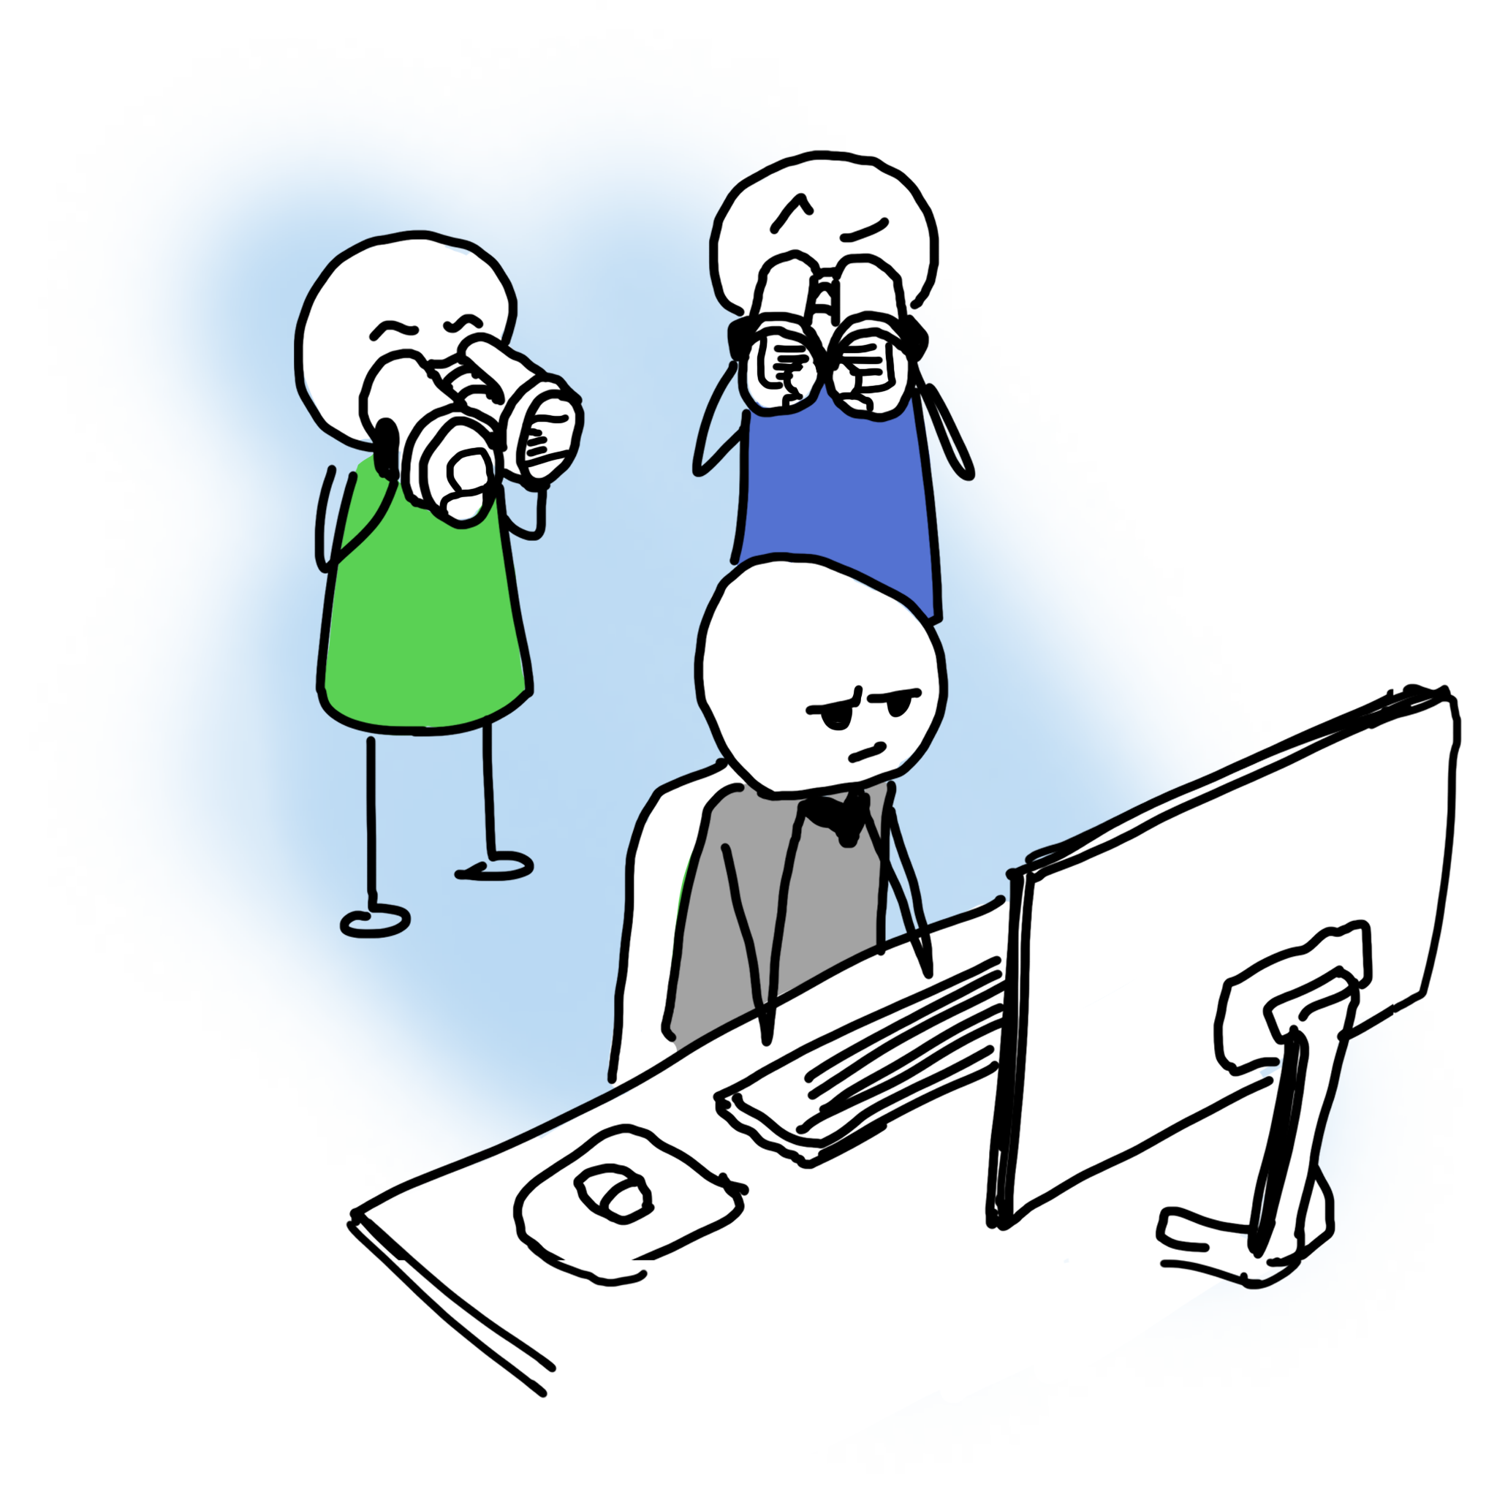
Surveilled Programming Hiring Surveillance
A rushed, live coding exercise where others judge your technique, typing, problem-solving, coding, and design as you work.

Slide 20
Surveilled Programming The Senior Critic
A person with formal authority visits and tells you what to do and what not to do. You have to do what they say. Disagreement is politically dangerous.

Slide 21
Surveilled Programming Burdensome Junior
You are saddled with an inexperienced programmer who watches you work and constantly asks you naive and shallow questions.

Slide 22
Surveilled Programming Impromptu Performance
Without warning or prep, you are expected to put on a show for an audience of your peers.

Slide 23
Surveilled Programming The Noisy Bullpen
You are trying to concentrate on your work while people around are moving through your space, having conversations, answering phone calls, and talking about their work (which is not your work).

Slide 24
Surveilled Programming The Cellmate
You are forced to play host. In addition to getting your work done, you also have to socialize and "play nice" all day. You aren't allowed to spend any time alone.

Slide 25
Lack of Safety
Trust doesn’t exist inside the team
Individuals don’t feel responsible for making the system better
Corporate Immune System is threatened
Leaders have to give up a little “power over the team”
Process is baked and served up to the team so they cannot self-manage
Notes:
Trust
Trust that everyone is doing the best job they can
Trust that ideas will be treated equitably and fairly
Trust that we’re all trying to get to a better place every day
Individuals
Resigned to how they work today.
Simply interested in being told what to do, how to work, etc.
In my experience, this is a trained behavior by an organization.

Slide 26
80%
of people expected to hate pairing
At the end of the study
90%
preferred programming in groups
Data from Pair Programming Illuminated by Williams and Kessler

Slide 27
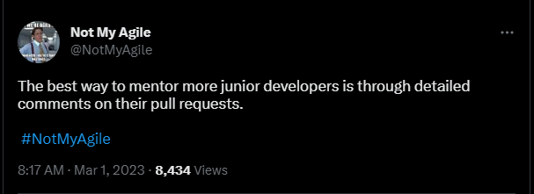

Slide 28
Working Together
4

Slide 29
Common Misconceptions about Working Together
Only the person typing can contribute
It’s actually the opposite. The people not typing are the ones programming.
Often comes from a fixed, static definition of contribution (fingers on keyboard)
People can “hide” and not contribute
It’s actually harder for people to not contribute when working together
Social pressure
Proximity and sheer time together makes this impossible

Slide 30
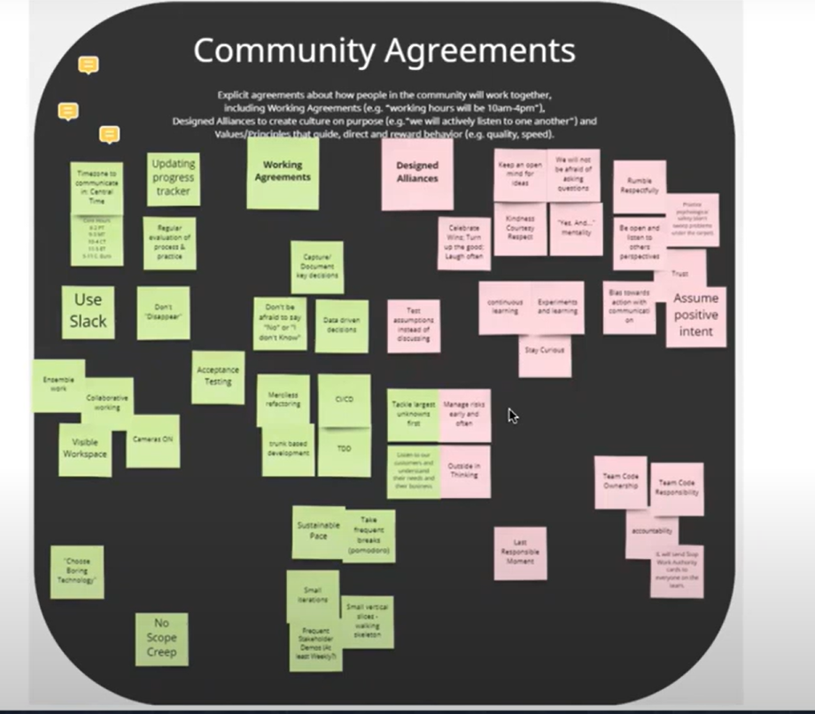
Team Chartering
From Paige Watson – Working The Way We Want

Slide 31
You decide to
Notes:
Nobody should force you to work together. That’s the fastest way to have people reject working together.

Slide 32
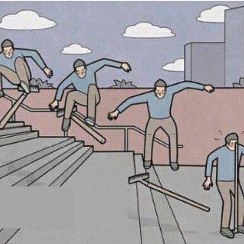
You’re going to suck

Slide 33

But soon... You wont
Notes:
Storm norm form
Everyone will innately start to understand everyone’s strengths and weaknesses, work within them, building themselves and each other up along those boundaries as a natural part of doing development.

Slide 34
There is no recipe for success There is no process that will work without you making it your own

Slide 35
5
What
Accounting IT
is doing &
has observed from doing it

Slide 36
Developer Feedback
I have worked on a vacation day, or worked when I was sick, because I felt pressure to complete the feature I was working on.

Slide 37
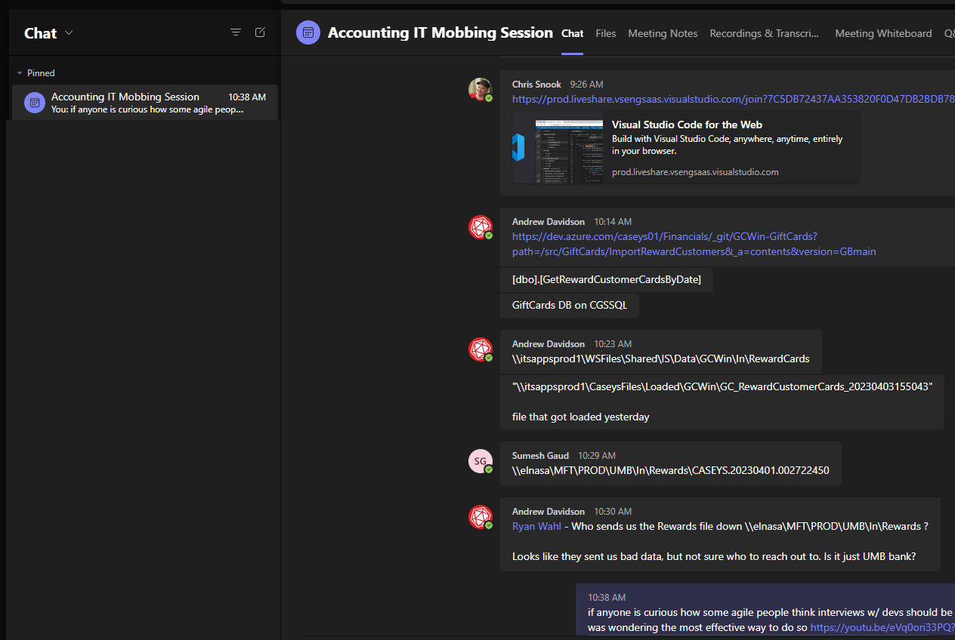
A Shared Space

Slide 38
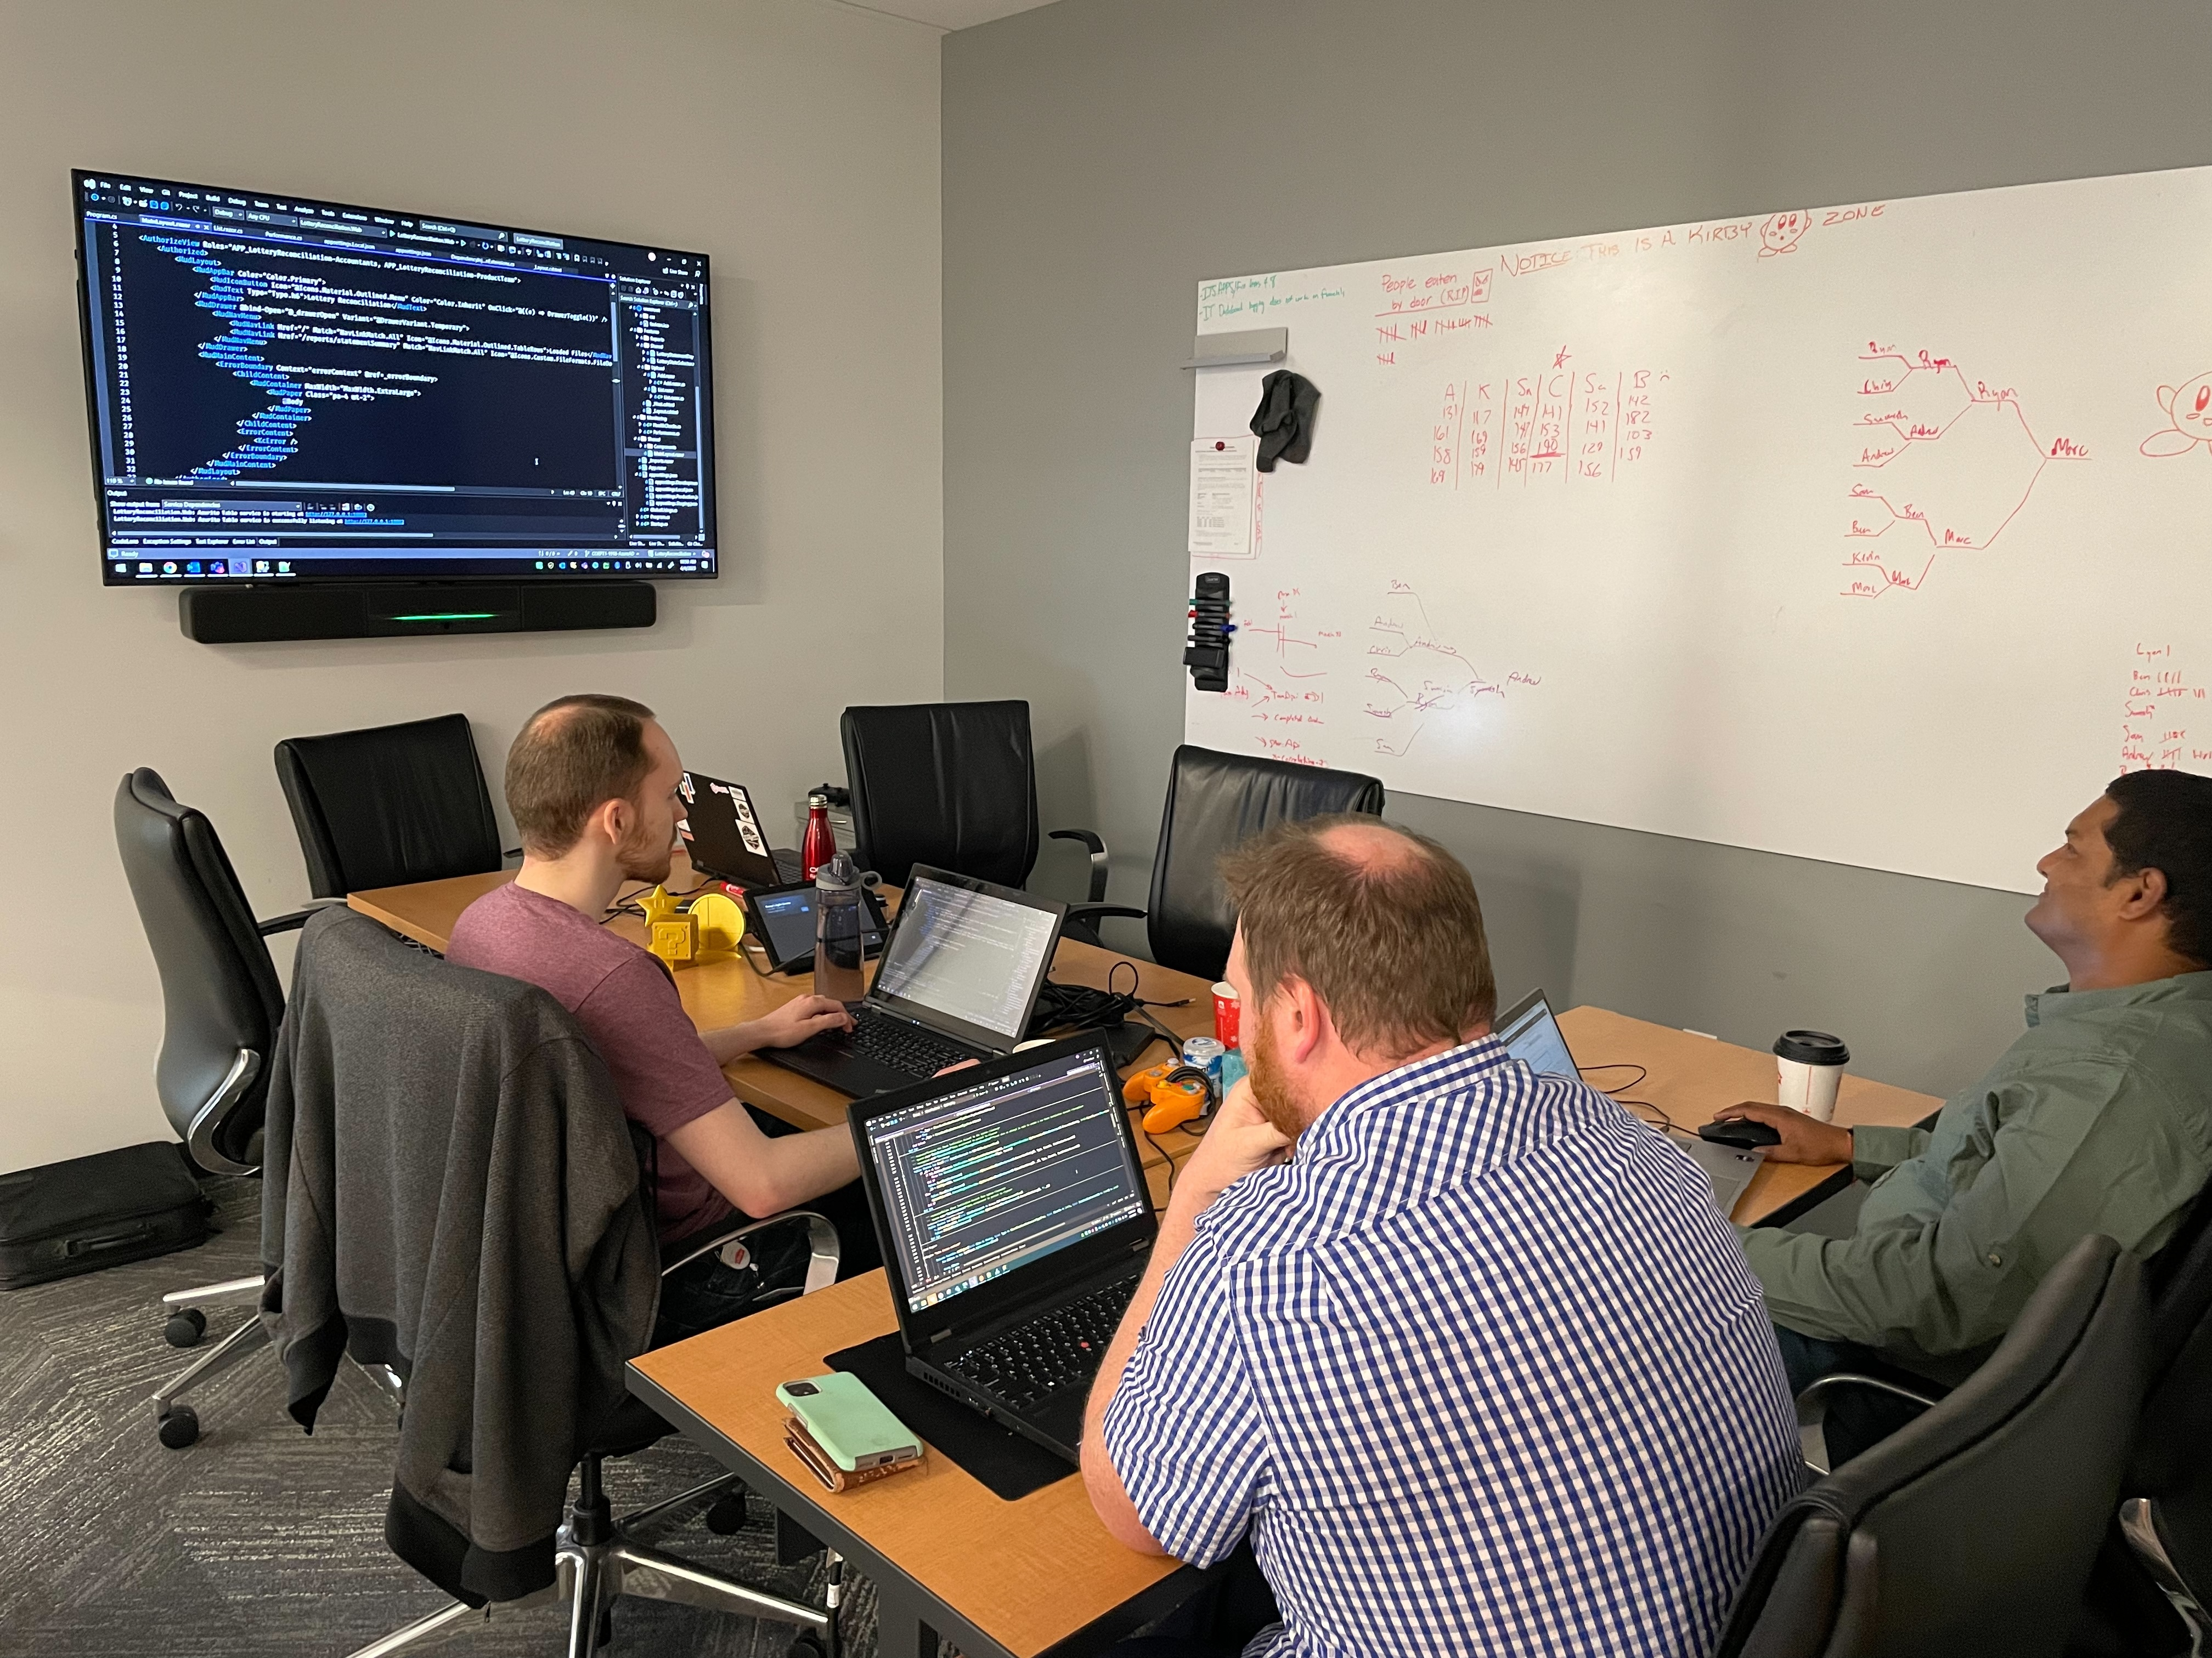
A Shared Space
Notes:
Talk about the Moblins board right outside this shot

Slide 39
Processes & Tools
Kanban by choice
Scrum at the edges to work w/ other teams
Try to keep WIP at 1
No work is assigned to individuals
Right-size stories
Sliced vertically so always shipping something valuable
3 story points = right size.
Remains un-pointed otherwise
Heavily use Visual Studio Live Share
A lot of other small processes, need for tools, etc. melt away.

Slide 40
The mob is a blob
- Ryan Wahl
Notes:
Ryan jumps in and out all the time - knows exactly where to go to get someone to help with something.

Slide 41
Our Mob Mentality
Come and go as needed
As micro-problems come up, people organically “call dibs” on the problem and track it down so the mob can continue with the core work.
After a few minutes, they bring the answer back
The person on our support rotation is supported
We often mob fires before they fester
Support people always have a safety net
Ryan pull people out when he needs something
As the work nears completion, a single person usually “shoots the goal” and does the glue work but the mob is ready should anything come up.

Slide 42
The Most Important Thing Always Gets Done
“Stop starting
Start Finishing”

Slide 43
Continuous Team Improvement
Changes happen organically – at the moment in time
Everyone has all the context for why the improvement is happening
So, we just stop/start doing the thing right then and there
Reduced emphasis on explicit retrospectives
Improvements that can be solved by the team never make it to the retrospective
They most often never make it to the end of the hour
Improving ourselves is part of the work
Improvements to how we work are made as we work
We embrace change – making a lot of little changes every single day

Slide 44
Continuous Personal Improvement
Everyone is a part of all the steps to shipping software
Less experienced developers can directly work with more experienced developers to learn and train – every single day.
More experienced developers learn how to teach – which is hard!
Everyone learns the products and technology
Specialization still happens based on preferences, but everyone has a wide breadth of knowledge on subjects both directly related to the business but also technical know-how
Notes:
After 2 – refer back to the “Valuable Software” slide.

Slide 45
A Shared Responsibility (“We Over Me”)
Everyone is going to work on the thing
Everyone is engaged in backlog refinement because we are all responsible for the implementation
Everyone works on the thing
Everyone gains an understanding of the feature as its codified
Everyone gains a deeper understanding of the system the feature is enhancing
Everyone has worked on the thing
Everyone was there for the ‘why’ and ‘how’
When questions arise, new features come in to further enhance the original feature, or something breaks – we all can lend a hand
People can go on vacation or be sick without any worry

Slide 46
Individuals & Interactions over Processes & Tools
Pull requests are mostly ceremonious
Our PRs are open for minutes
Operate almost entirely face-to-face (or on video calls)
Bring our PO (or even the person who asked) directly in the mob to showcase and offer feedback immediately

Slide 47
We are uncovering better ways of developing software by doing it and helping others do it.
- The very first sentence of the Agile Manifesto

Slide 48
Questions?

